Slide 1

Cross selling Vehicle Insurance to Health Insurance Customers- A Machine Learning Approach
Poojitha Bhat

Slide 2

Why Cross-Sell?
Increasing revenues
Usage of existing customer base
Optimization using ML can aide better strategies.

Slide 3
Data Collection and Preparation

Slide 4
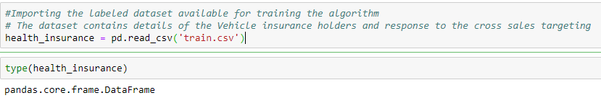
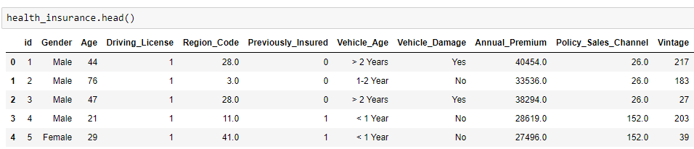
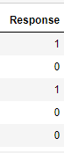
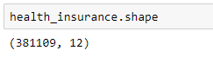
Data sourcing and initial analysis
Unique identifier of customer,
Age,
Driving License(Yes or No),
Region code,
Whether the customer has been previously insured,
Premium paid by the customer, Sales channel,
Number of days for which the customer ahs been on books,
Response(Yes or No)

Slide 5
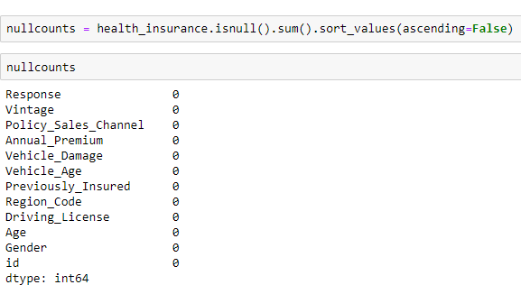
Null values analysis

Slide 6
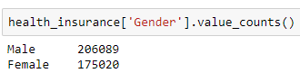
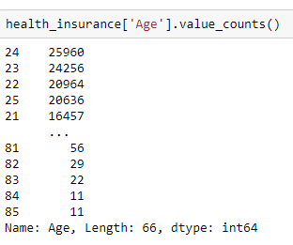
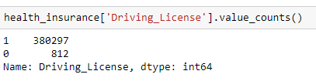
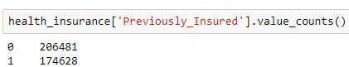
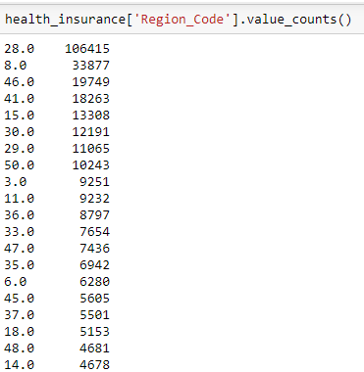
Variable Analysis

Slide 7
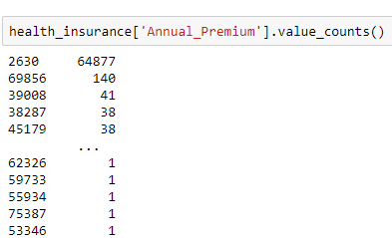
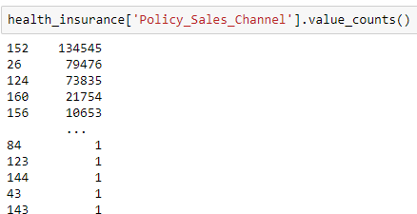
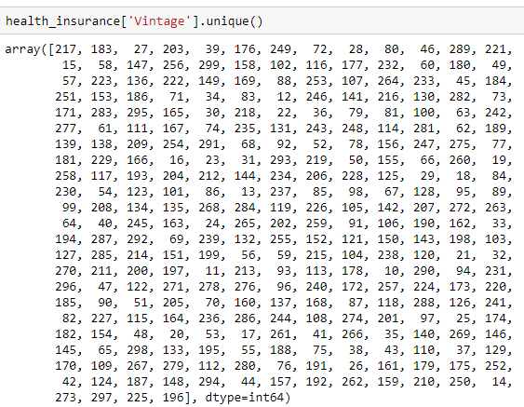
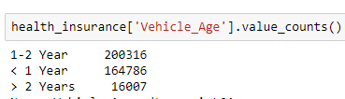
Variable Analysis

Slide 8
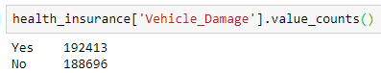
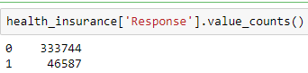
Variable Analysis

Slide 9
Exploratory Data Analysis of the health insurance holders

Slide 10
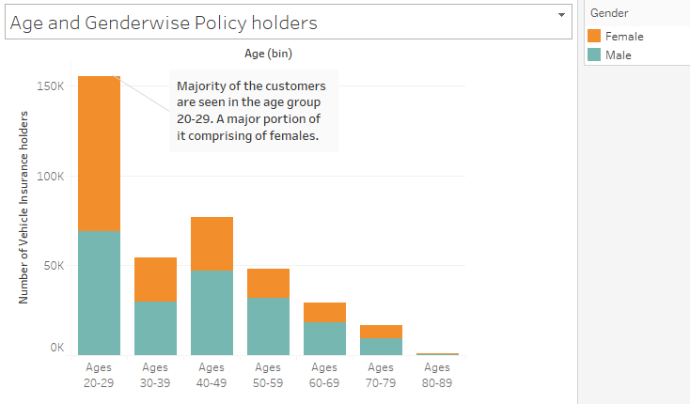
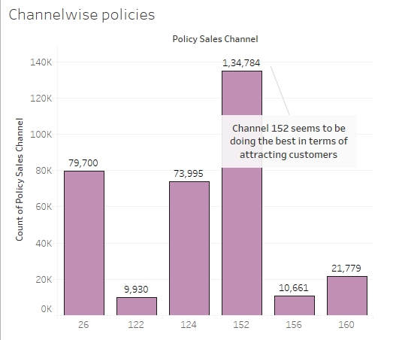
Binning of Age groups
Channels with over 9000 customers.
152- Internet
124- Third Party agencies
26- Direct Response
160- Affinity groups
156- Agents

Slide 11
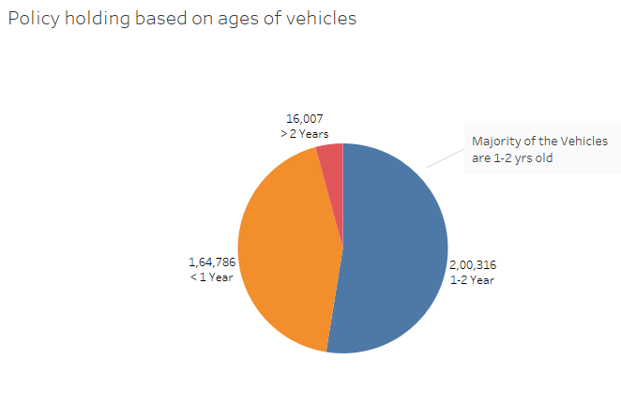
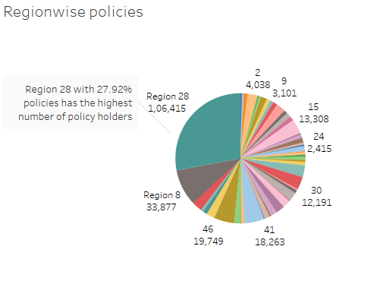
Region 28 – West Bengal
Region 8 – Haryana
Region 46- Goa
Region 41- Andhra Pradesh
Region 15- Maharashtra

Slide 12
EDA on the responses received

Slide 13
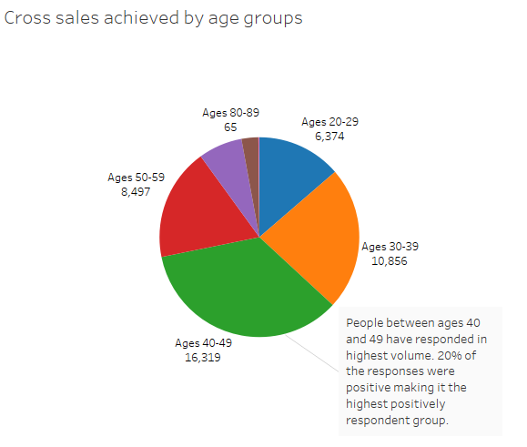
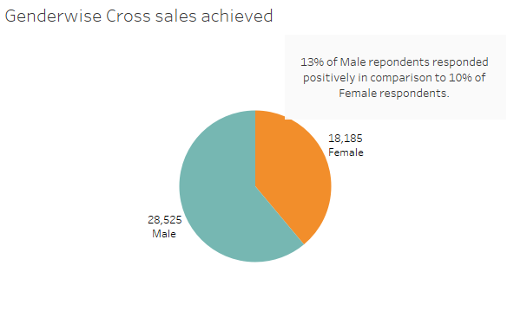

Slide 14
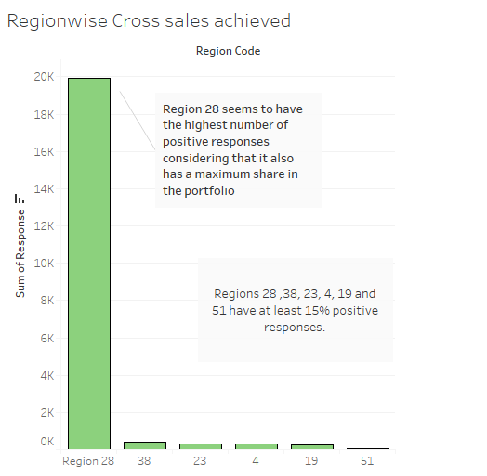
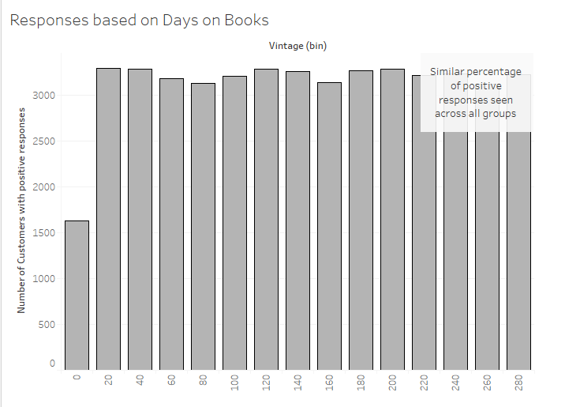
Percentage?

Slide 15
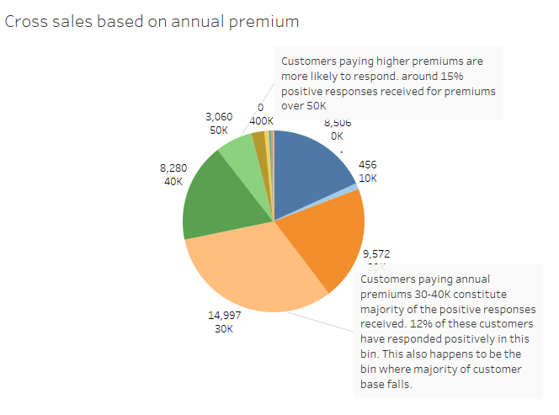

Slide 16
Pre-Processing

Slide 17
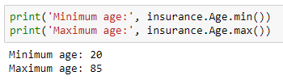
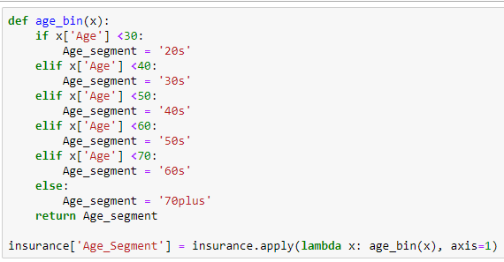
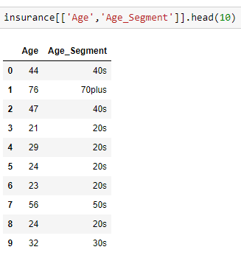
Binning-Age

Slide 18
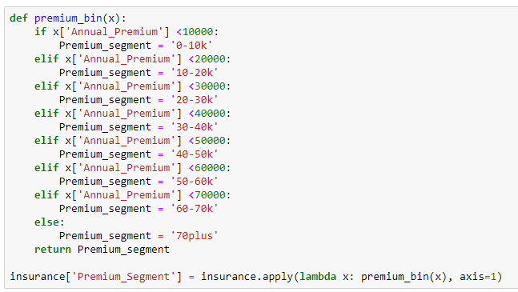
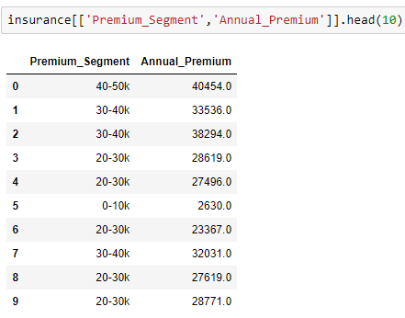
Binning- Annual Premium

Slide 19
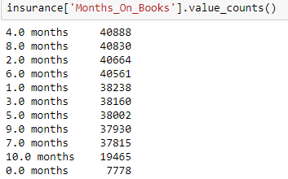
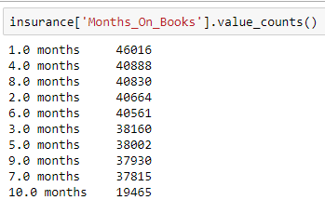
Binning- Vintage/MOBs

Slide 20
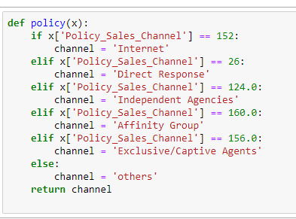
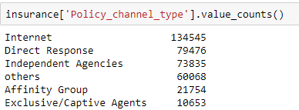
Binning -Channels

Slide 21
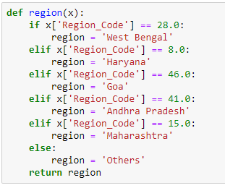
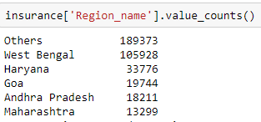
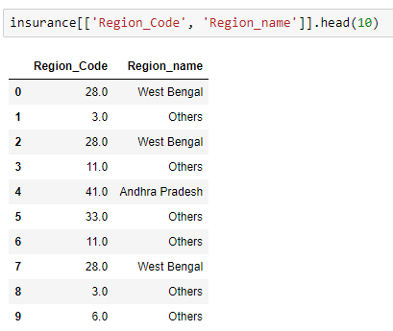
Assigning region names

Slide 22
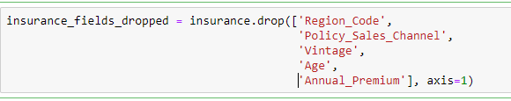
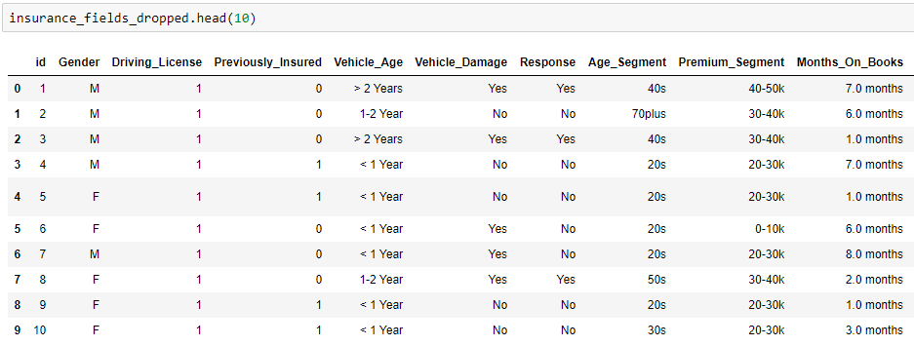
Dropping the parent columns

Slide 23
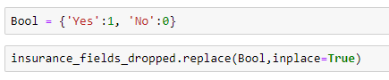
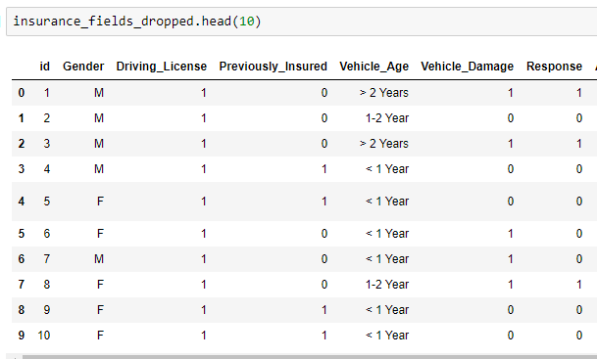
Replacing Boolean Characters with 0 and 1

Slide 24
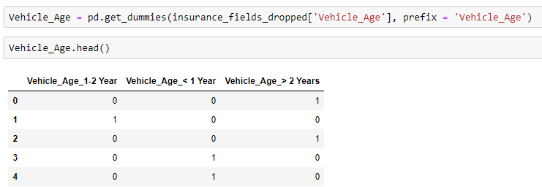
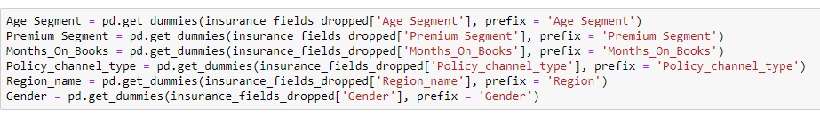
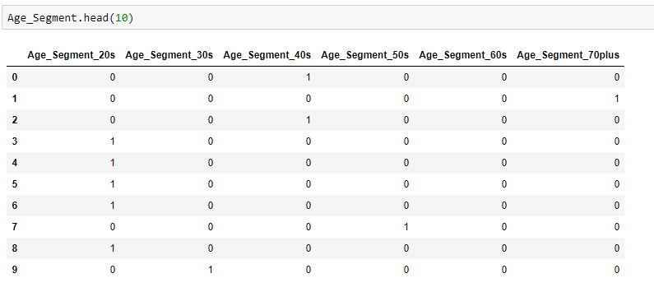
One Hot Encoding

Slide 25
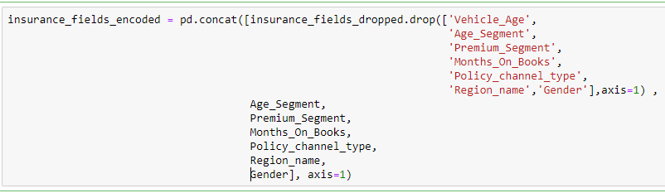
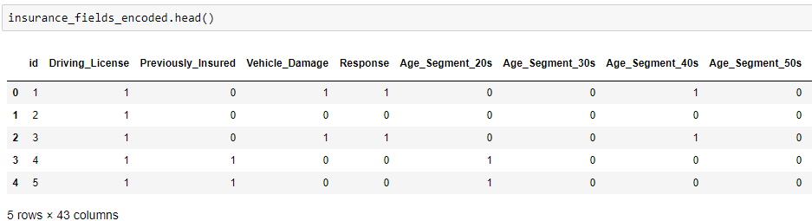
Dropping the parent columns

Slide 26
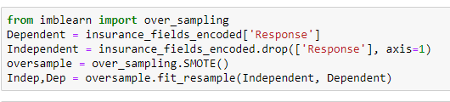
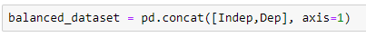
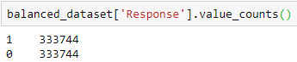
Handling Imbalanced Data

Slide 27
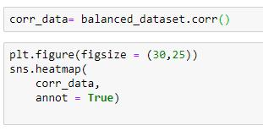

Correlation Analysis
People who have been previously insured or have claimed expenses due to vehicle damage are seen to be less likely to respond to the cross sales.
People are also less likely to respond when contacted over internet.
As expected, the age group has a correlation with the channel through which the customers are reached.

Slide 28
MODELING

Slide 29



Logistic Regression

Slide 30


Tuning the Penalty value

Slide 31




Decision Tree Classifier- Default parameters

Slide 32



Gini Decision Tree Classifier- Parameter tuning

Slide 33


Entropy Decision Tree Classifier- Parameter tuning

Slide 34




Plotting Learning Curves

Slide 35


Random Forest Classifier- Default Parameters

Slide 36



Random Forest Classifier- Tuned Hyperparameters

Slide 37



Gradient Boosting Classifier

Slide 38



Comparing the performances of all the models
Gradient Boosting Classifier is giving the best performance.

Slide 39
Observations and Conclusion
Gradient Boosting is seen to have the highest area under the curve but is having more false positives for a higher number of True positives.
Random Forest is seen to be having a slightly lower AUC. It is classifying True positives and a smaller rate of False positives.
In case of Insurance leads, a False positive only leads to a customer who is less likely to respond to a cross sale lead. Hence we are OK with a higher True positive rate at the cost of a small False negative rate.
Gradient Boosting algorithm can be chosen for further testing.

Slide 40
Thank you!

